Slide 1
For-loop, While-loop, Factorization

Slide 2
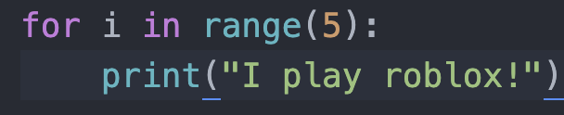
Revision on For Loop!
Colon!
Tab!
Hidden Value of i | For-loop block
I = 0 | print(“I play roblox!”)
I = 1 | print(“I play roblox!”)
I = 2 | print(“I play roblox!”)
I = 3 | print(“I play roblox!”)
I = 4 | print(“I play roblox!”)

Slide 3
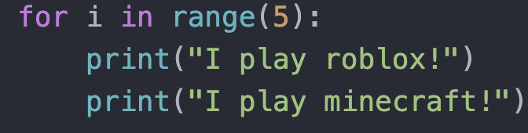
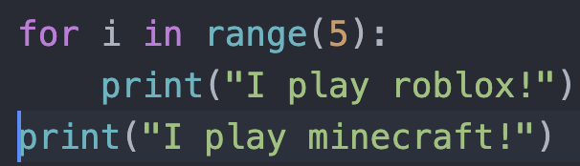
Differences between these two…?
TAB!
No TAB!

Slide 4
Tab determines BLOCKS!
Both lines in the for-loop!

Slide 5
Tab determines BLOCKS!
One line in the for-loop!
This line is not tabbed! It is not repeated 5 times!

Slide 6
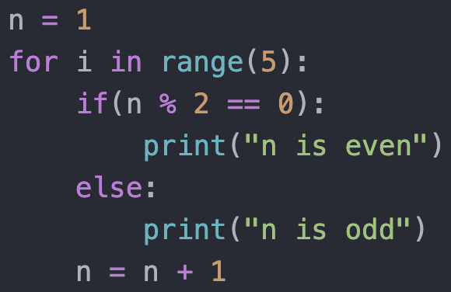
SO MANY TABS!
1 Tab: Within for-loop
2 Tabs: Within for-loop, within if
1 Tab: Within for-loop
2 Tabs: Within for-loop, within else
1 Tab: Within for-loop

Slide 7
How do we find the factors of a number?

Slide 8
State their factors!
2
4
6
9
12
19
24

Slide 9
State their factors!
2:1,2
4
6
9
12
19
24

Slide 10
State their factors!
2: 1,2
4: 2,4
6
9
12
19
24

Slide 11
State their factors!
2: 1,2
4: 1,2,4
6: 1,2,3,6
9
12
19
24

Slide 12
State their factors!
2: 1,2
4: 1,2,4
6: 1,2,3,6
9: 1,3,9
12
19
24

Slide 13
State their factors!
2: 1,2
4: 1,2,4
6: 1,2,3,6
9: 1,3,9
12: 1,2,3,4,6,12
19 (prime numbers)
24

Slide 14
State their factors!
2: 1,2
4: 1,2,4
6: 1,2,3,6
9: 1,3,9
12: 1,2,3,4,6,12
19: 1,19
24

Slide 15
State their factors!
2: 1,2
4: 1,2,4
6: 1,2,3,6
9: 1,3,9
12: 1,2,3,4,6,12
19: 1,19
24: 1,2,3,4,6,8,12,24

Slide 16
How to find factors with coding?

Slide 17
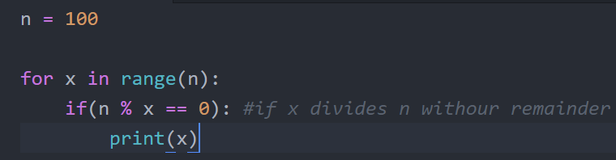
Solution

Slide 18
Division by 0
1/0.5 = 2
1/0.25 = 4
1/0.125 = 8
1/0.00001 = 100000
1/0.00000001 = 10000000
1/0 = ??????????

Slide 19
for-loop to while-loop

Slide 20
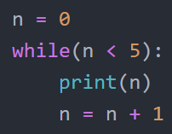
WHILE LOOP!
Play around with the range of n!

Slide 21
WHILE LOOP!
Condition such that the while loop continues
while!
COLON!
TAB!
TAB!

Slide 22
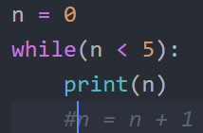
Hmmmmm...
What would happen?

Slide 23
Hmmmmm...
N stays at 0, and the condition is met forever, so this loop never ends!!!!

Slide 24
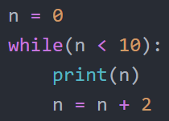
Another example of while
What would this print?

Slide 25
Another example of while
First iteration
print(0)
N = 0 + 2 = 2

Slide 26
Another example of while
First iteration
print(0)
N = 0 + 2 = 2
Second iteration
print(2)
N = 2 + 2 = 4

Slide 27
Another example of while
First iteration
print(0)
N = 0 + 2 = 2
Second iteration
print(2)
N = 2 + 2 = 4
Third iteration
print(4)
N = 4 + 2 = 6

Slide 28
Another example of while
First iteration ( 0 < 10)
print(0)
N = 0 + 2 = 2
Second iteration (2 < 10)
print(2)
N = 2 + 2 = 4
Third iteration (4 < 10)
print(4)
N = 4 + 2 = 6
Fourth iteration (6 < 10)
print(6)
N = 6 + 2 = 8

Slide 29
Another example of while
First iteration ( 0 < 10)
print(0)
N = 0 + 2 = 2
Second iteration (2 < 10)
print(2)
N = 2 + 2 = 4
Third iteration (4 < 10)
print(4)
N = 4 + 2 = 6
Fourth iteration (6 < 10)
print(6)
N = 6 + 2 = 8
Fifth iteration (8 < 10)
print(8)
N = 8 + 2 = 10

Slide 30
Another example of while
First iteration ( 0 < 10)
print(0)
N = 0 + 2 = 2
Second iteration (2 < 10)
print(2)
N = 2 + 2 = 4
Third iteration (4 < 10)
print(4)
N = 4 + 2 = 6
Fourth iteration (6 < 10)
print(6)
N = 6 + 2 = 8
Fifth iteration (8 < 10)
print(8)
N = 8 + 2 = 10
Sixth iteration (10 = 10) -> end

Slide 31
Your Turn!

Slide 32
Task 2
Use a for loop and print “I play mario kart” 10 times

Slide 33
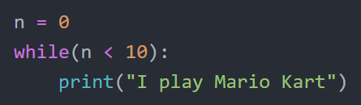
Task 2 Solution

Slide 34
Task 3
Calculate 2+3+4+... + 103 using while loop

Slide 35
iteration | n | x
1 | 2 | 2 = 2
2 | 3 | 2+3 = 5
3 | 4 | 2+3+4 = 9
4 | 5 | 2+3+4+5 = 14

Slide 36
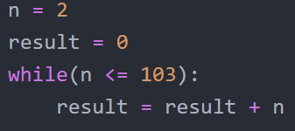
Task 3 Solution

Slide 37
Task 4
Repeatedly multiply a number by 2 until it is bigger than 2048

Slide 38
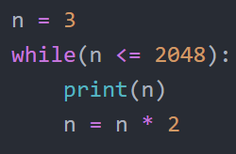
Task 4 Solution

Slide 39
Classwork/Homework Time!

